Slide 1
COMP3150 Assignment 1 (Individual)

Slide 2
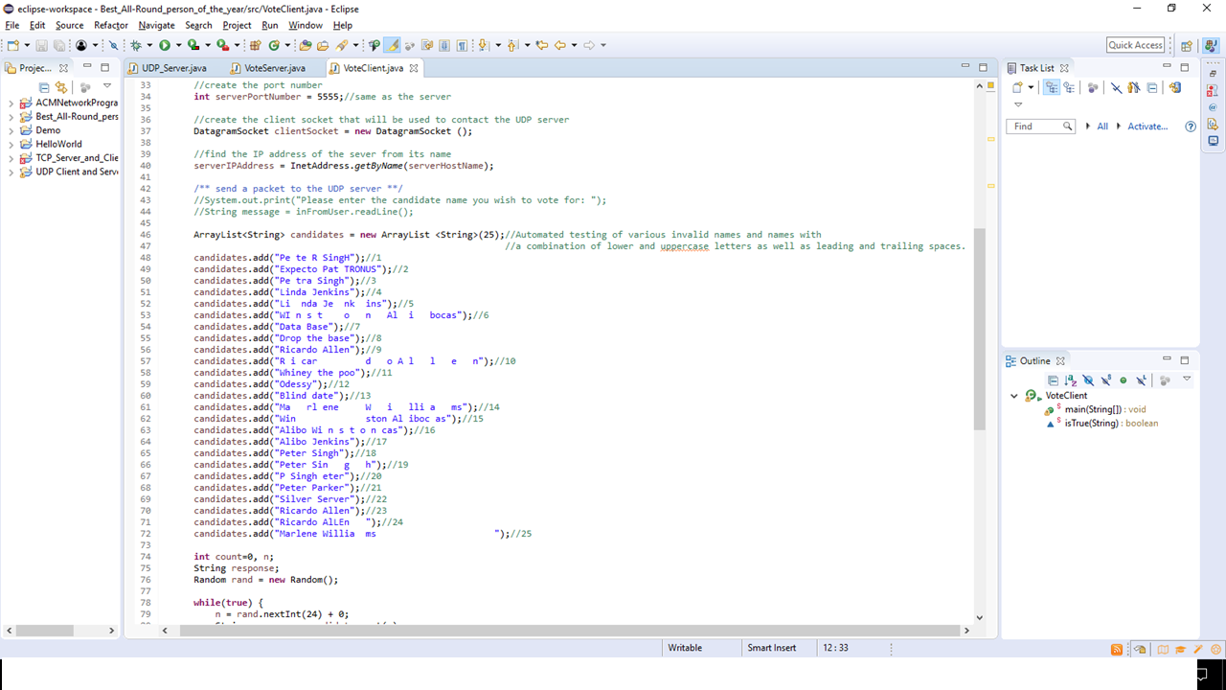
Notes:
This is a screen shot of the input data that was automated in the client server

Slide 3
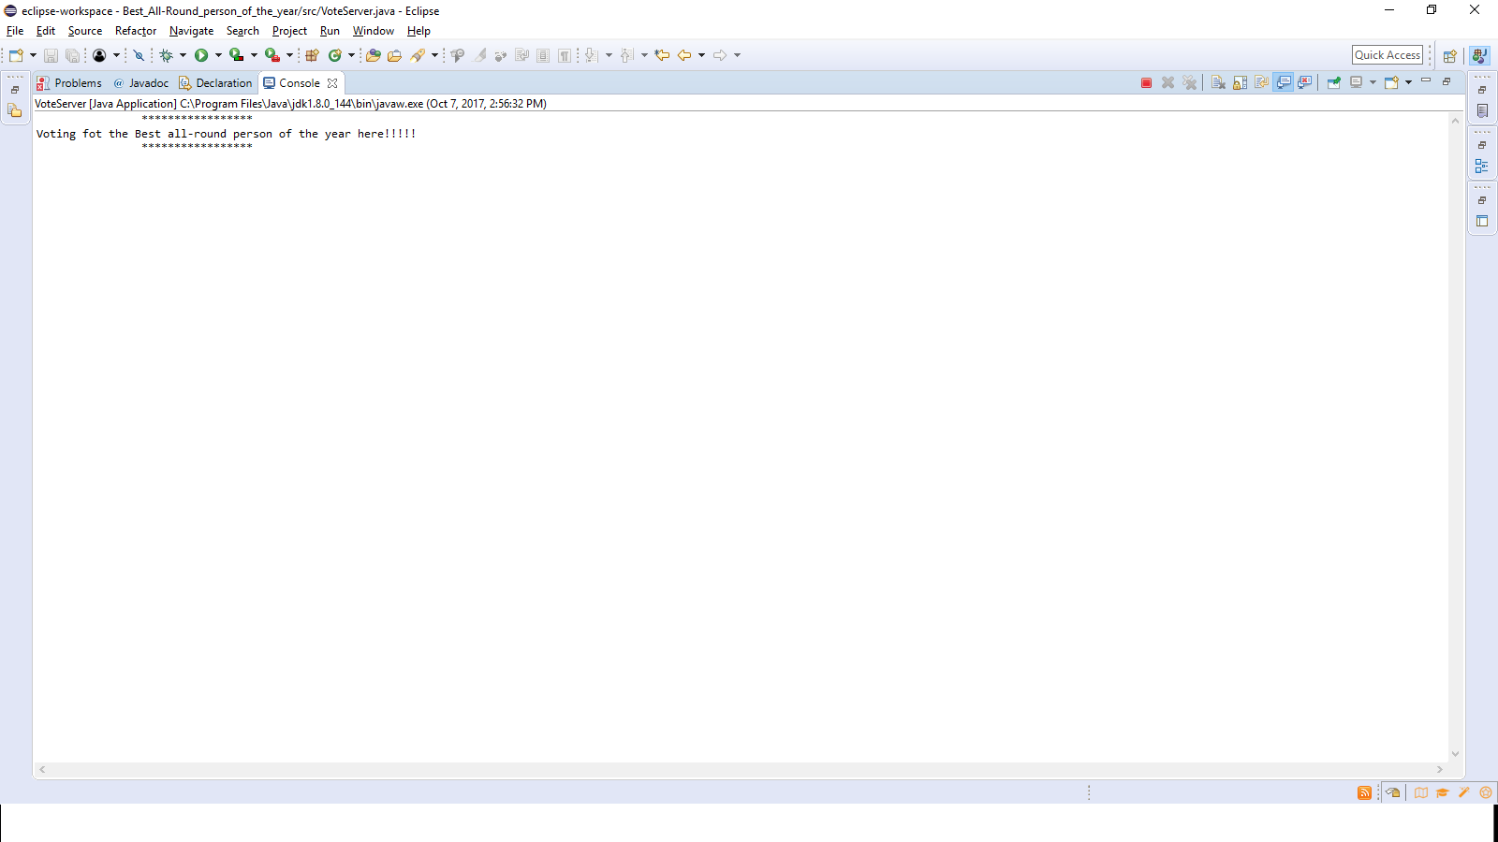
Notes:
This is a screen shot of the server while running awaiting packets

Slide 4
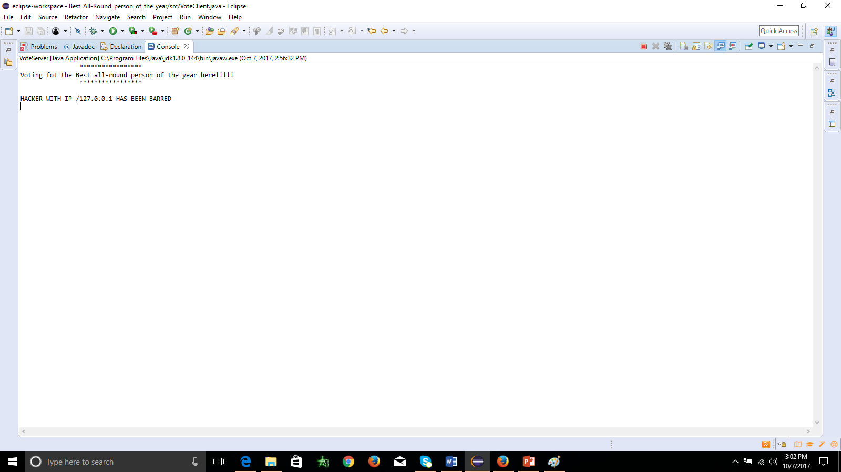
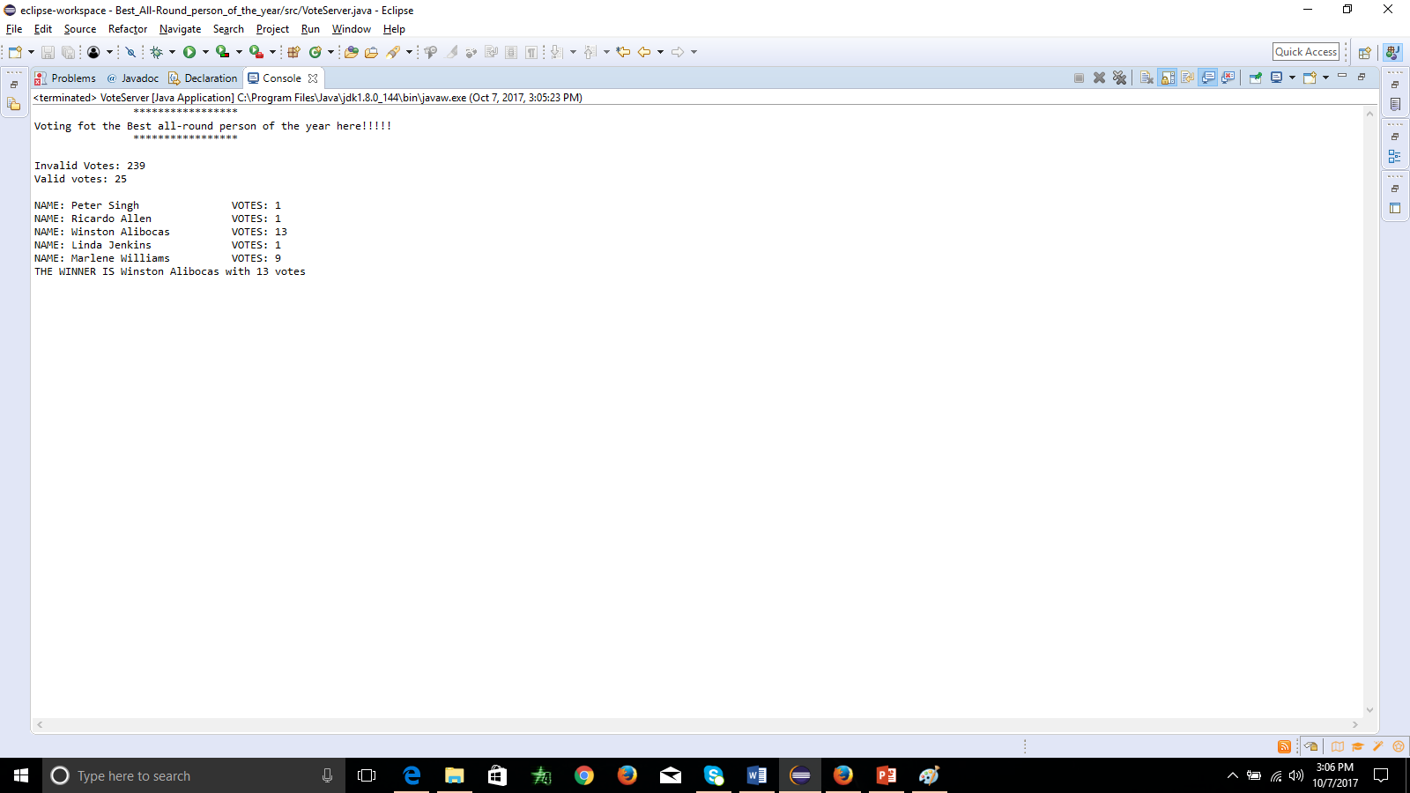
Server Blocking Client|Server Accepting |Client DATA

Slide 5
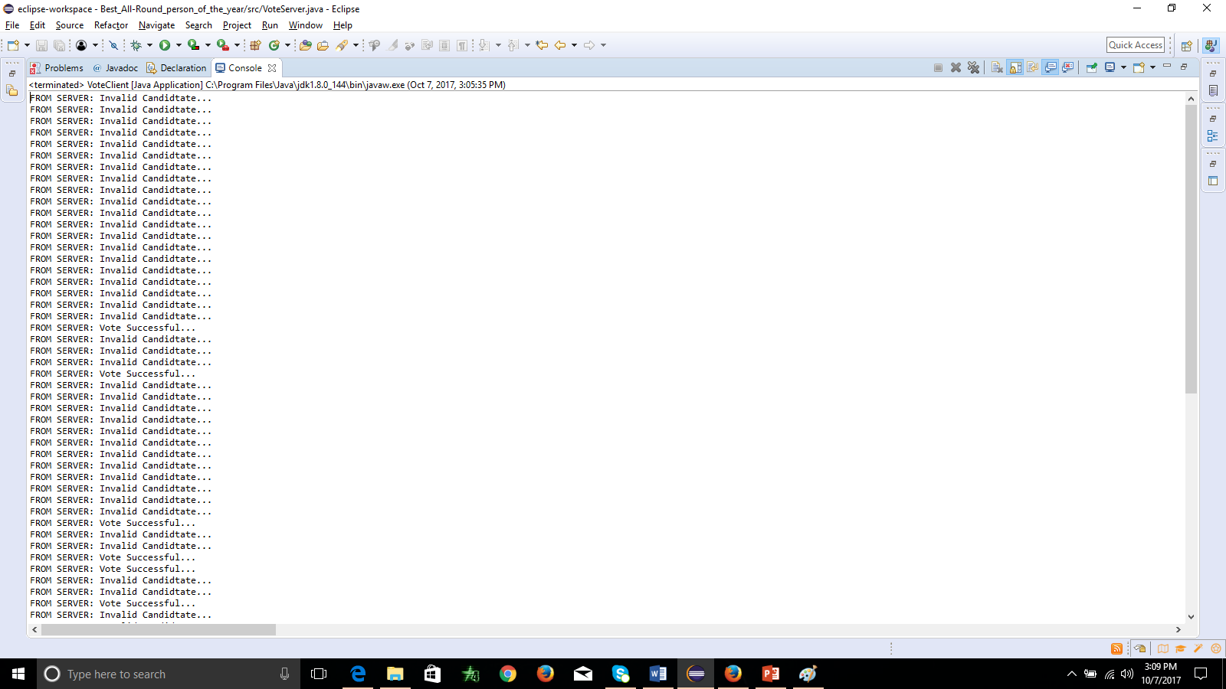
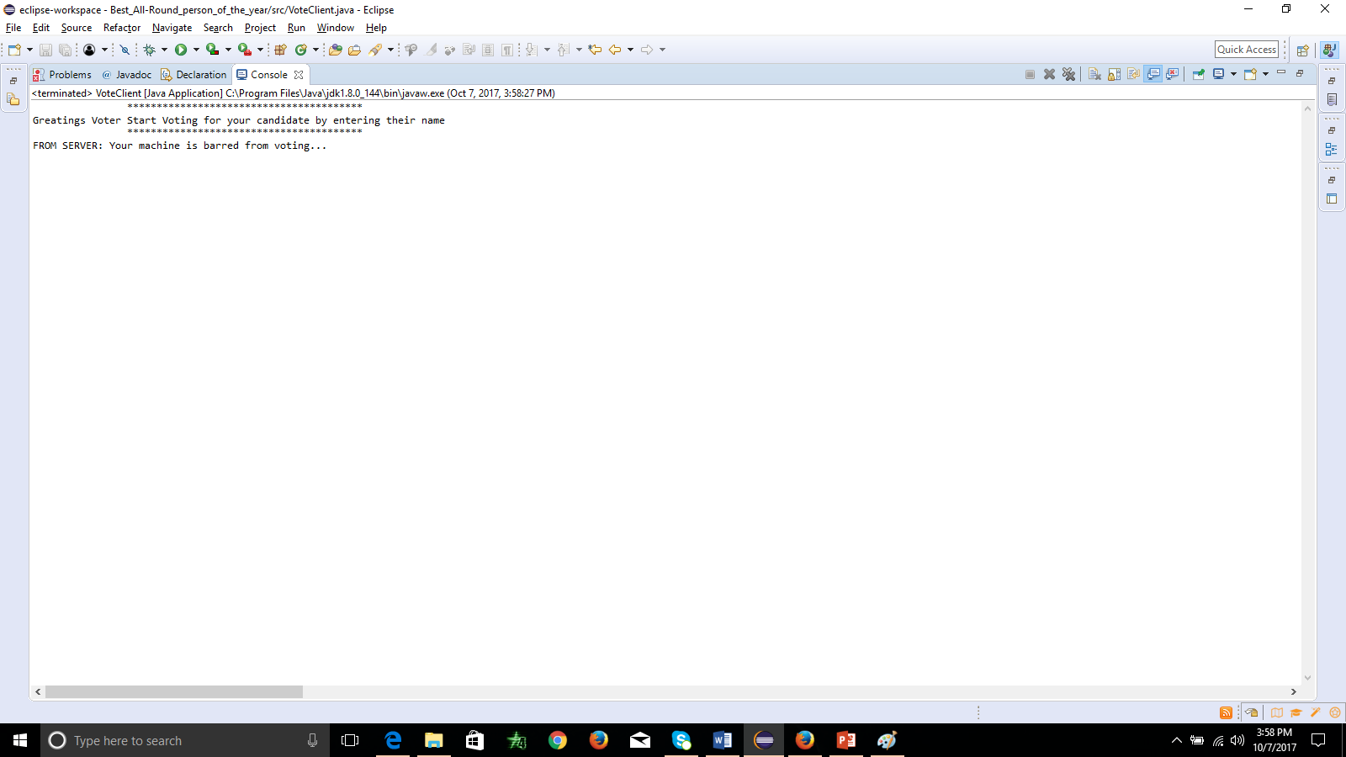
Client during automated test | Client receiving blocked IP message

Slide 6
The program worked fairly well it didn’t crash but the while loops at first didn’t appear to end in cases where I had while(n<=25){…} and a if(…){n++} there was difficulty in getting it to come to and end. This was however solved. I think attempted all what was asked to do and I completed about 97% of what was required accurately.

